Slide 1
Software Design Patterns
- Susan Lo Lama

Slide 2
Table of Content:
Introduction
Types of Software Design Patterns
1. Creational Design Patterns
1.1 Singleton Method Design Pattern
1.2 Factory Method Design Pattern
1.3 Abstract Method Design Pattern
1.4 Builder Method Design Pattern
1.5 Prototype Method Design Pattern
2. Structural Design Patterns
2.1 Adapter Method Design Pattern

Slide 3
2.2 Bridge Method Design Pattern
2.3 Composition Method Design Pattern
2.4 Decorator Method Design Pattern
2.5 Facade Method Design Pattern
2.6 Proxy Method Design Pattern
2.7 Flyweight Method Design Pattern
3. Behavioral Design Patterns
3.1 Observer Method Design Pattern
3.2 Strategy Method Design Pattern
3.3 State Method Design Pattern
3.4 Command Method Design Pattern

Slide 4
3.5 Chain of Responsibility Method Design Pattern
3.6 Template Method Design Pattern
3.7 Interpreter Method Design Pattern
3.8 Visitor Method Design Pattern
3.9 Mediator Method Design Pattern
3.10 Momento Method Design Pattern
III. References

Slide 5
I. Introduction:
Software Design Pattern is a reusable solution to a common problem in software development.
Key Characteristics of Design Patterns:
Reusability: Can be applied across different projects.
Standardization: Provides a common language for developers.
Efficiency: Speeds up development by reusing proven solutions.
Flexibility: Adaptable to various scenarios and needs.

Slide 6
II. Types of Software Design Patterns:
Creational Patterns: Focus on object creation mechanisms
Structural Patterns: focus on how classes and objects are composed to form larger structures.
Behavioral Patterns: Focus on how objects interact and communicate

Slide 7
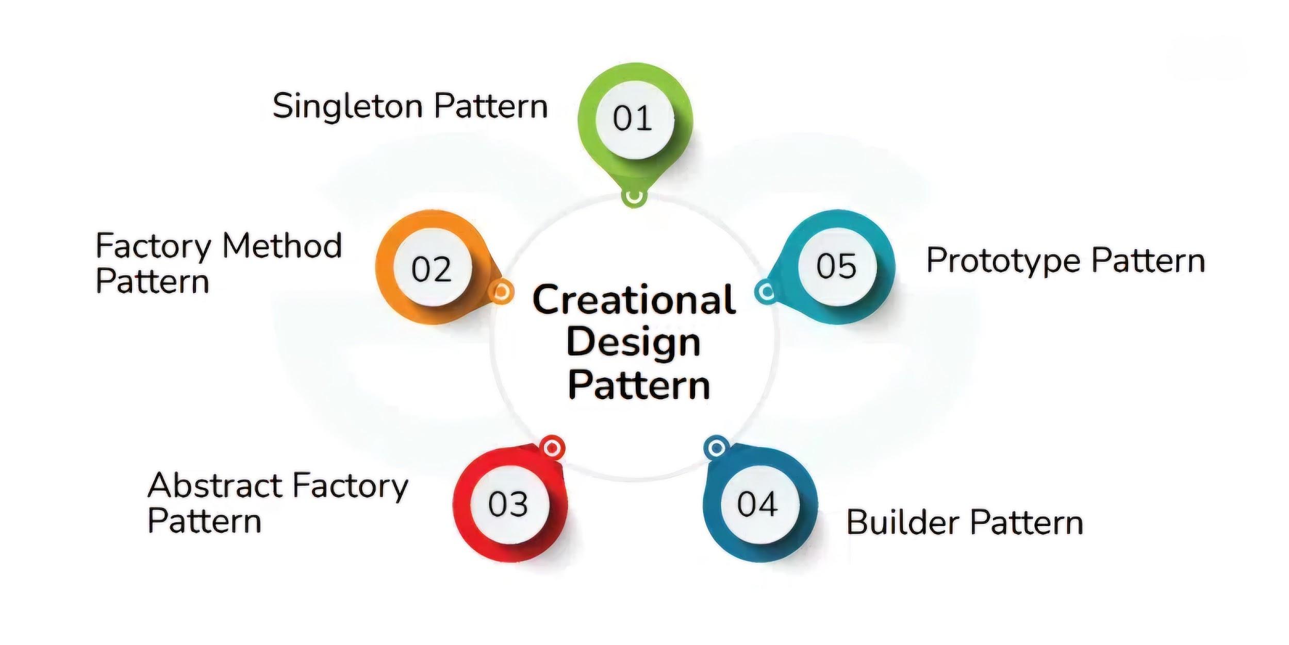
Creational Design Patterns:
Deal with object creation mechanisms, abstracting the instantiation process to make systems more flexible and independent of how objects are created.
Types:

Slide 8
1.1 Singleton Method Design Pattern:
It ensures a class only has one instance, provides a global point of access.
Features:
Single Instance Guarantee: Prevents multiple instances, saving memory and ensuring consistency.
Global Access: Provides a single, unified access point for shared resources.
State Consistency: Ensures the same instance is used throughout, avoiding conflicting states.
Thread Safety: Prevents race conditions in multithreaded environments.

Slide 9
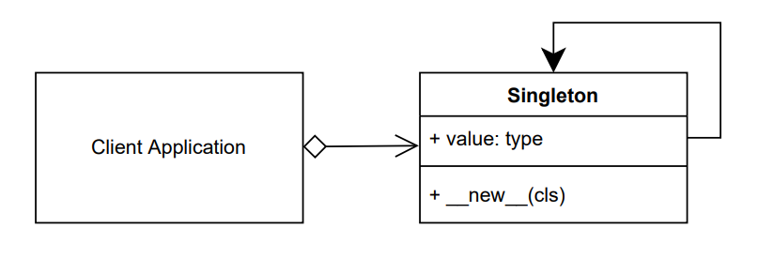

Slide 10
Use Cases:
Logging: Centralized logging system for consistency.
Configuration Management: Single access point for application settings.
Database Connections: Manage a shared connection pool efficiently.
Limitation:
Limited to one instance: Only one instance can exist, restricting flexibility when multiple instances are needed.

Slide 11
1.2 Factory Method Design Pattern:
Factory Method creates objects without specifying their exact class, letting subclasses decide.
It provides multiple instances, overcoming the limitation of the Singleton pattern.
Features:
Decouples Object Creation: Separates object creation logic from the main code.
Simplifies Scalability: Easily add new types without major changes to existing code.
Keeps Code Clean: Reduces messy and hard-to-maintain code structures.

Slide 12
Components:
Creator: Abstract class/interface with the factory method, defines a way to create products.
Concrete Creator: Implements the factory method to create specific products.
Product: Defines a common interface for all objects created by the factory.
Concrete Product: Actual products that implement the Product interface.

Slide 13
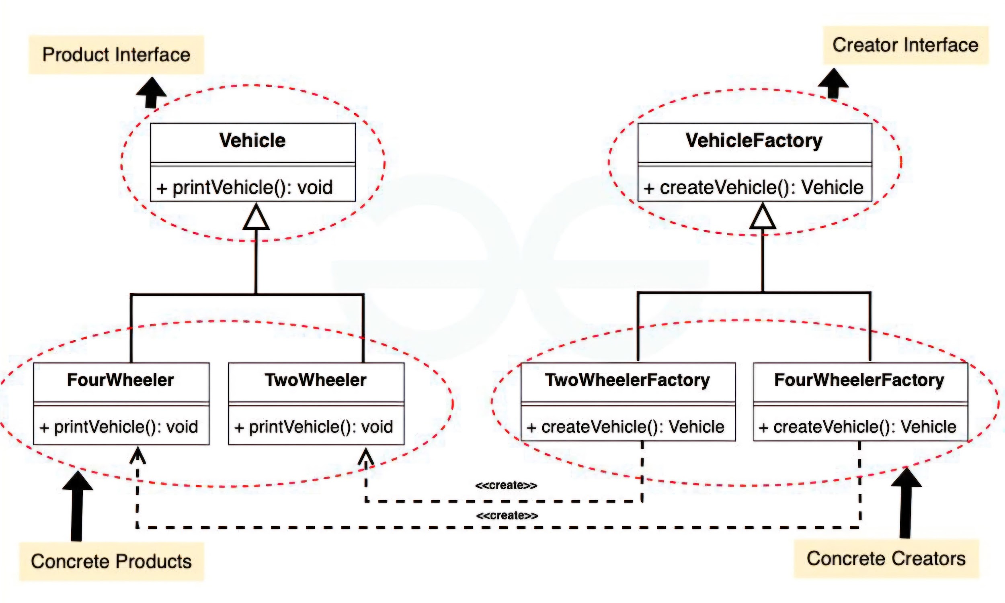

Slide 14
Use Cases:
Dynamic Object Creation: Instantiate objects based on runtime input or conditions.
Framework Design: Extend frameworks by allowing subclasses to specify object creation.
Loose Coupling: Create objects without specifying their exact class, enhancing flexibility.
Limitation:
It can increase complexity with multiple factory classes.

Slide 15
1.3 Abstract Factory Method Design Pattern:
It provides an interface to create families of related or dependent objects.
It creates related object families, overcoming the Factory Method limitation.
Features:
Simplifies Object Creation: Centralizes complex object creation.
Scalable and Maintainable: Easily add new products without modifying existing code.
Loose Coupling: Reduces dependency between client code and concrete products.

Slide 16
Components:
Abstract Factory: Declares methods for creating abstract products. It defines a set of related products but doesn’t specify how to create them.
Concrete Factory: Implements the abstract factory methods to create specific families of products.
Abstract Product: Defines an interface for a product.
Concrete Product: Implements the abstract product interface, representing a specific product in a family.

Slide 17
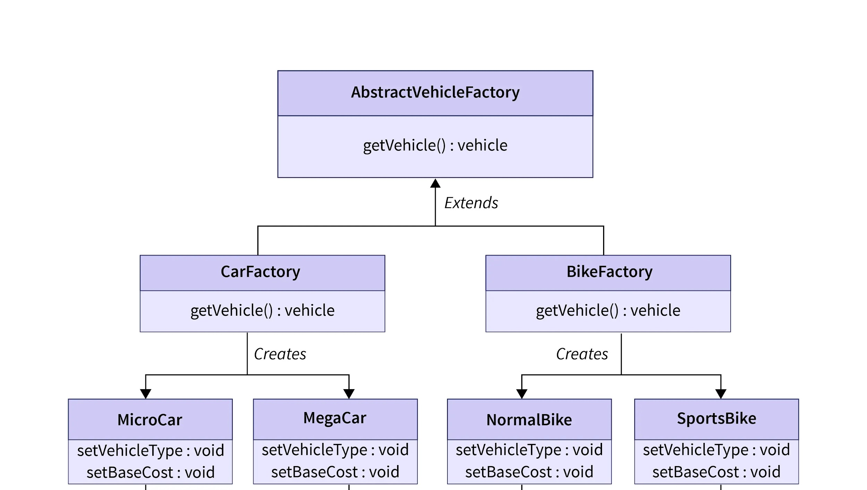

Slide 18
Use Cases:
Creating Related Product Families: Ensures compatibility among objects from multiple families.
Extensibility and Scalability: Allows easy addition of new product families while supporting adaptability to different environments.
Limitation:
Complex Object Assembly: Difficult to construct objects step-by-step with varying configurations.

Slide 19
1.4 Builder Method Design Pattern:
It Separates the construction of complex objects from their representation, allowing flexible and step-by-step creation.
It builds complex objects step by step, overcoming Abstract Factory's limitation.
Features:
Complex Object Creation: Simplifies creation of complex objects.
Flexibility: Builds different variations with the same process.
Separation: Separates construction from the representation (final product).

Slide 20
Components:
Product: The complex object being built, consisting of multiple parts.
Builder: An interface that defines methods for constructing parts of the product.
ConcreteBuilder: Implements the Builder interface, constructing specific parts of the product.
Director: Manages the construction process, coordinating the Builder to create the product.
Client: Initiates the construction by providing the Builder to the Director.

Slide 21
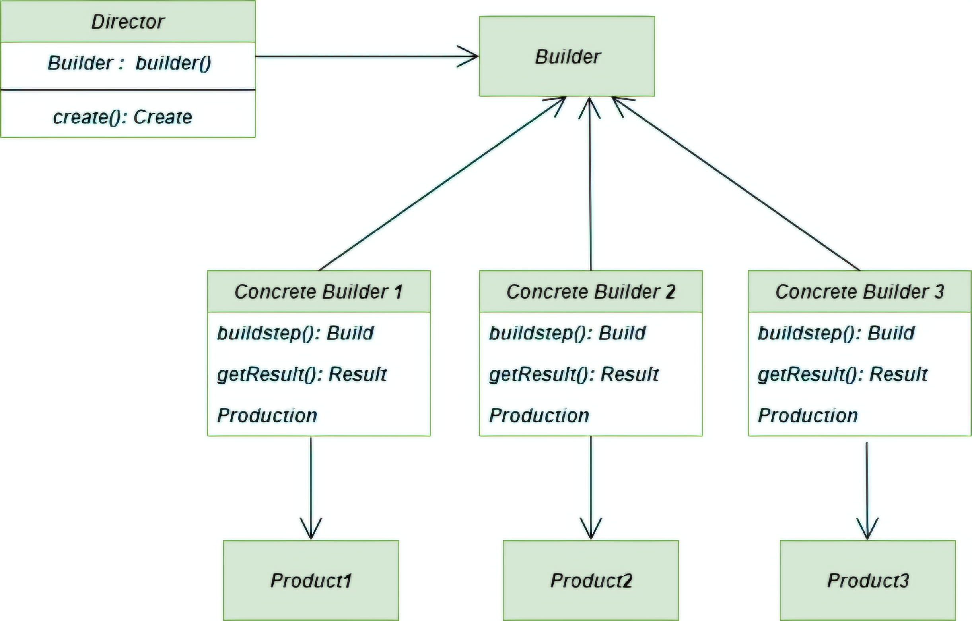

Slide 22
Use Cases:
Step-by-Step Construction: Builds objects incrementally, step by step.
Complex Object Creation: Handles objects with many components or configurations.
Separation of Concerns: Separates construction from representation (final form).
Limitation:
Repetitive and Resource-Intensive: Creating multiple complex objects requires repeating the same construction steps, consuming unnecessary resources.

Slide 23
1.5 Prototype Method Design Pattern:
It clones existing objects to create new ones, simplifying object creation.
It clones objects, avoiding repetitive construction and overcoming the Builder method's limitation.
Features:
Object Cloning: Create new objects by copying an existing one.
Avoids Repetition: No need to manually write object creation logic each time.
Creates Complex Objects Easily: Simplifies complex object creation.

Slide 24
Components:
Prototype Interface: Defines the contract for cloning objects.
Concrete Prototype: Implements the cloning logic for specific objects.
Client: Requests new objects by cloning existing ones.
Cloning Method: Process of creating copies of objects based on a prototype.

Slide 25
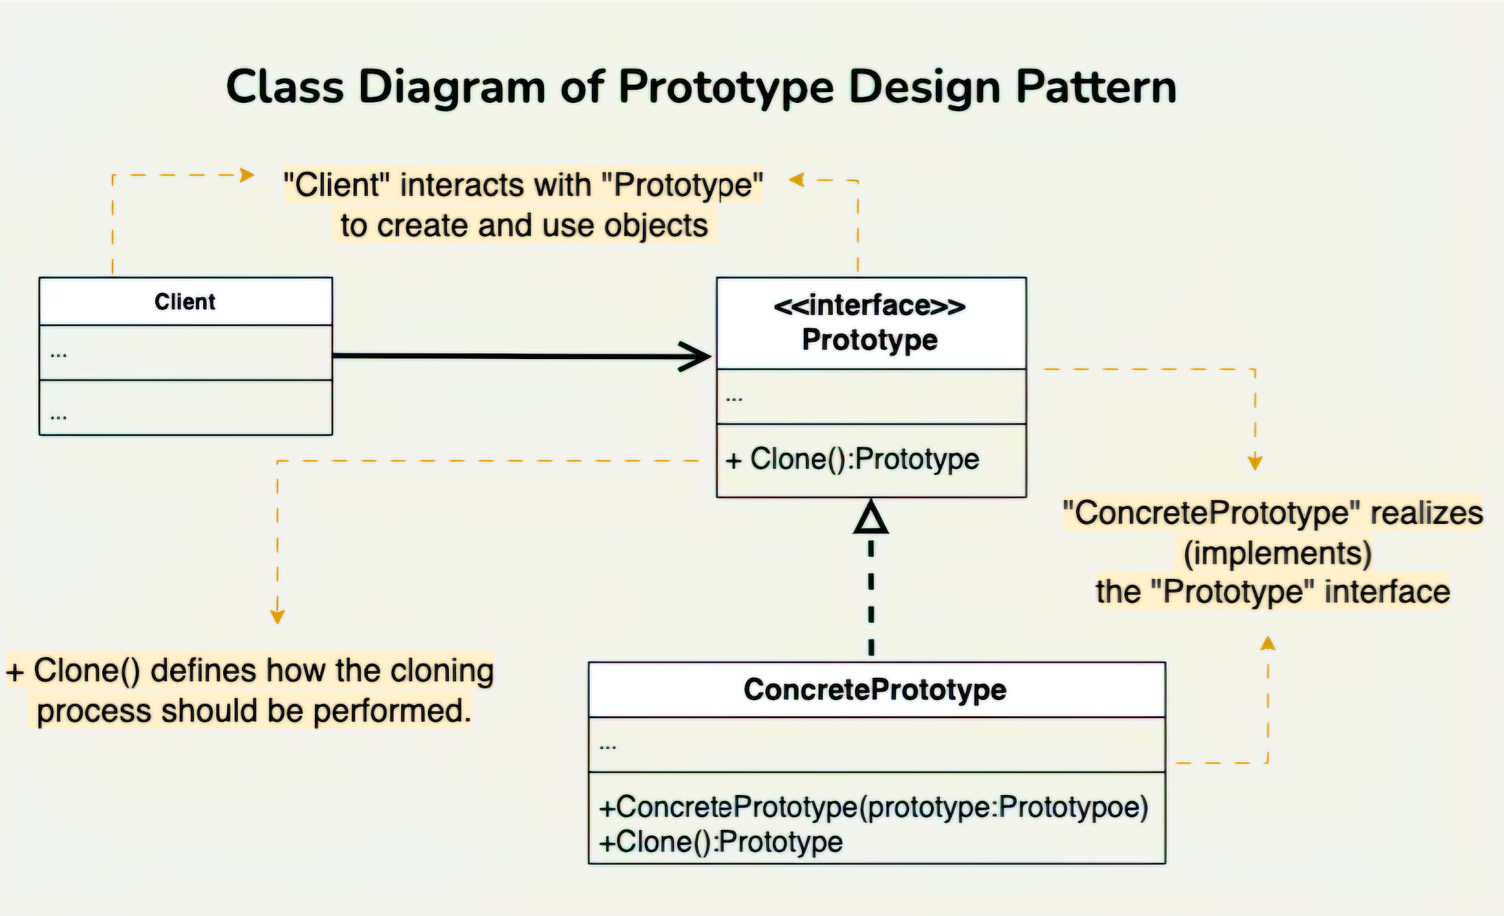

Slide 26
Use Cases:
Object Cloning: Efficiently creates copies of objects when creation is resource-intensive.
Game Object Management: Clones game entities with variations (e.g., characters, weapons).
Configuration Cloning: Creates different configurations by cloning and modifying base settings.
Dynamic Object Creation: Creates objects at runtime with slight modifications from prototypes.

Slide 27
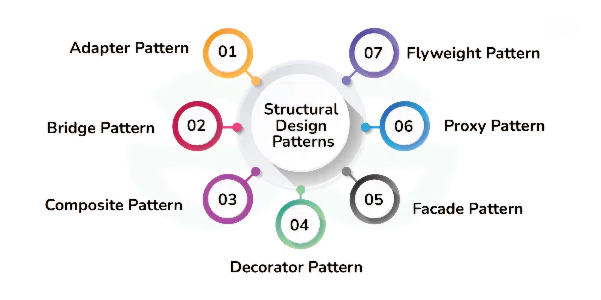
2. Structural Design Patterns:
It address how classes and objects are combined to form efficient, flexible structures, using inheritance to compose interfaces or implementations.
Types:

Slide 28
2.1 Adapter Method Design Pattern:
It allows incompatible interfaces to work together by converting one interface to another.
Features:
Interface Incompatibility: Bridges incompatible interfaces.
Reusability: Reuses existing code without modification.

Slide 29
Components:
Target: The interface the client expects to interact with.
Adaptee: The existing class that needs to be adapted.
Adapter: The class that implements the target interface and translates requests to the adaptee.

Slide 30
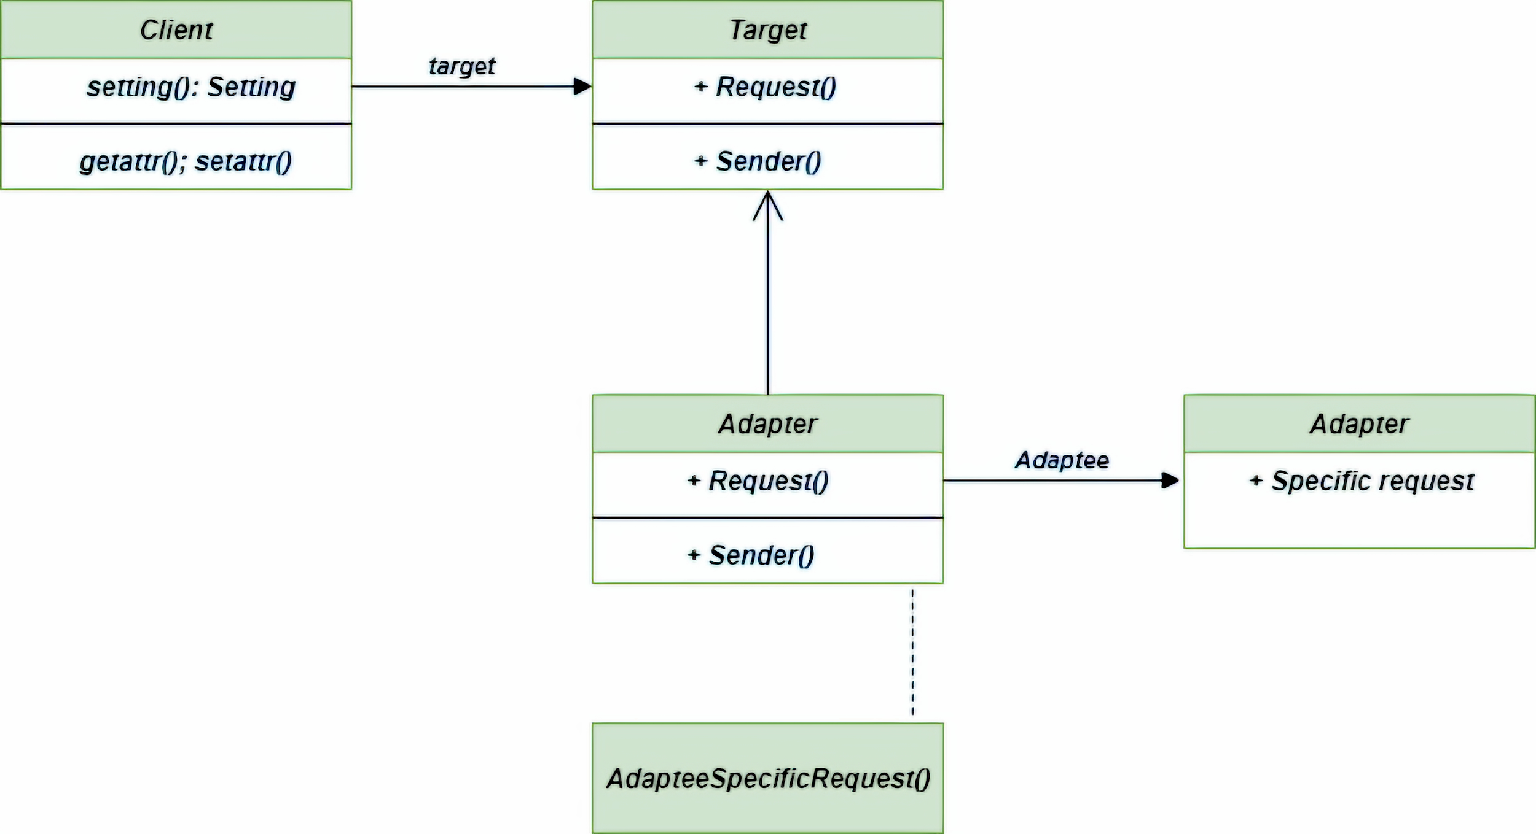

Slide 31
Use Cases:
Legacy System Integration: Adapting old systems to work with new ones.
Incompatible Interfaces: Enabling classes with different interfaces to communicate.
Third-Party Library Integration: Adapting external libraries to fit your system.

Slide 32
2.2 Bridge Method Design Pattern:
It separates the abstraction from its implementation, enabling both to evolve independently and enhancing flexibility in the system.
Features:
Decouples Abstraction and Implementation: Allows independent evolution of both, enhancing flexibility and scalability.
Promotes Reusability: Enables code reuse across different abstractions and implementations.
Reduces Complexity: Simplifies managing multiple variations of abstraction and implementation.

Slide 33
Components:
Abstraction: Core element, holds a reference to the implementer.
Refined Abstraction: Extends the abstraction, hiding finer details.
Implementer: Defines the interface for implementation, which may differ from the abstraction.
Concrete Implementation: Provides the actual implementation for the implementer interface.

Slide 34
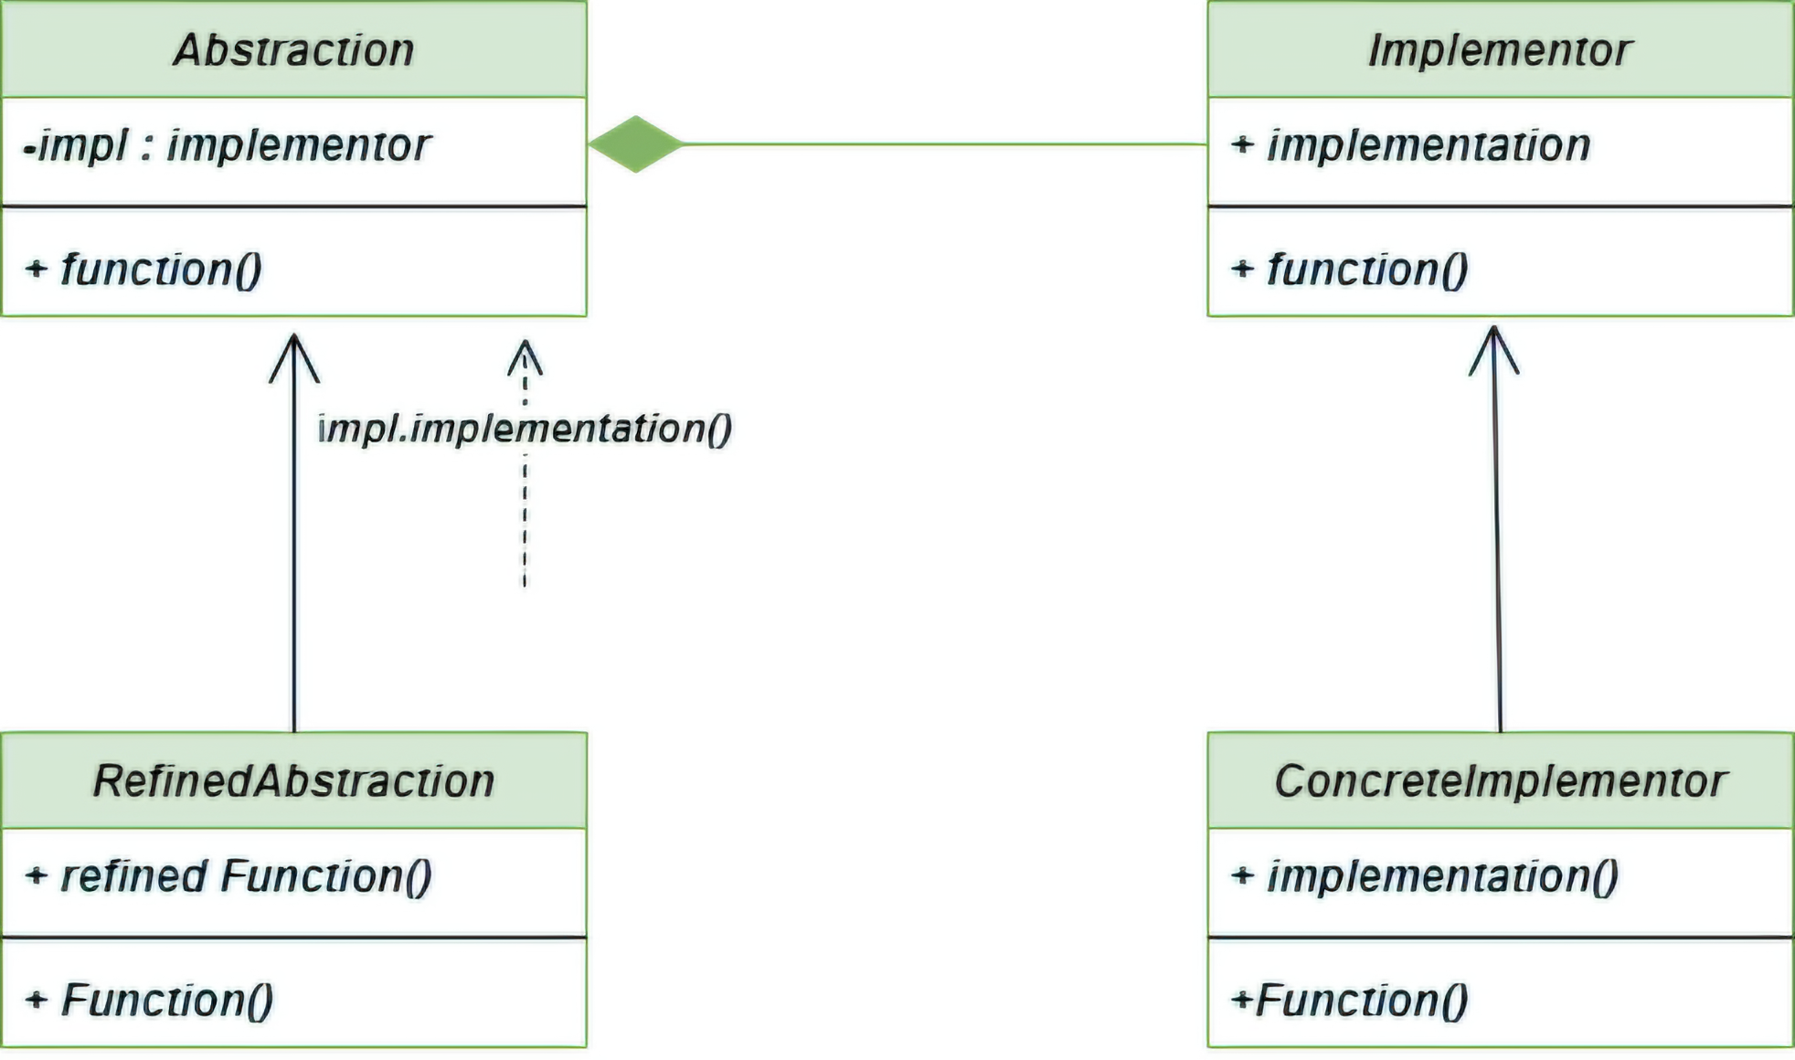

Slide 35
Use Cases:
Multiple Implementations: To vary implementations independently.
Complex Systems: To manage complex abstractions and implementations.
Cross-Platform Development: For apps that work across different platforms.

Slide 36
2.3 Composite Method Design Pattern:
It is a structural pattern that allows treating individual objects and compositions of objects uniformly in tree-like hierarchies.
Features:
Uniform Treatment: Common interface for individual and composite objects.
Tree Structure: Represents part-whole hierarchies.
Simplified Operations: Perform operations on all objects without distinction.
Flexibility: Easily add or remove components in the hierarchy.

Slide 37
Components:
Component: Common interface for all objects, defines shared methods.
Leaf: Individual object with no children, implements the Component interface.
Composite: Container for Leaf and other Composite objects, implements Component interface and manages children.
Client: Uses the Component interface to interact with Leaf and Composite objects uniformly.

Slide 38
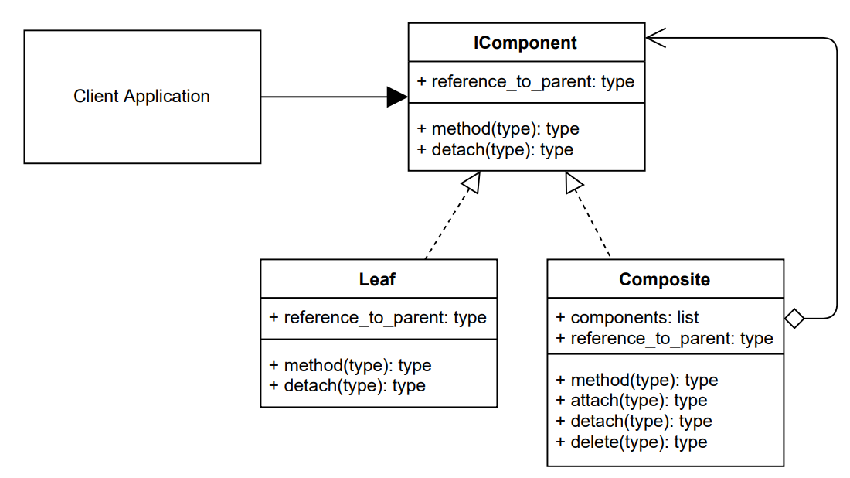

Slide 39
Use Cases:
Nested Tree Structures: For hierarchical systems like organizational charts or file systems.
Document Structure: To manage paragraphs, sections, and documents in word processors.
Menu Systems: For handling menu items and submenus uniformly.

Slide 40
2.4 Decorator Method Design Pattern:
It is a structural pattern that adds behavior to objects dynamically without altering other objects of the same class.
Features:
flexible Behavior: Dynamically adds behavior without modifying the class.
Class Explosion: Avoids creating many subclasses.
Extensibility: Easily extends behavior with decorators.

Slide 41
Components:
Component Interface: Defines common operations for components and decorators.
Concrete Component: Basic object implementing the Component interface.
Decorator: Abstract class adding behavior to the component.
Concrete Decorator: Extends Decorator, adding specific functionalities.

Slide 42
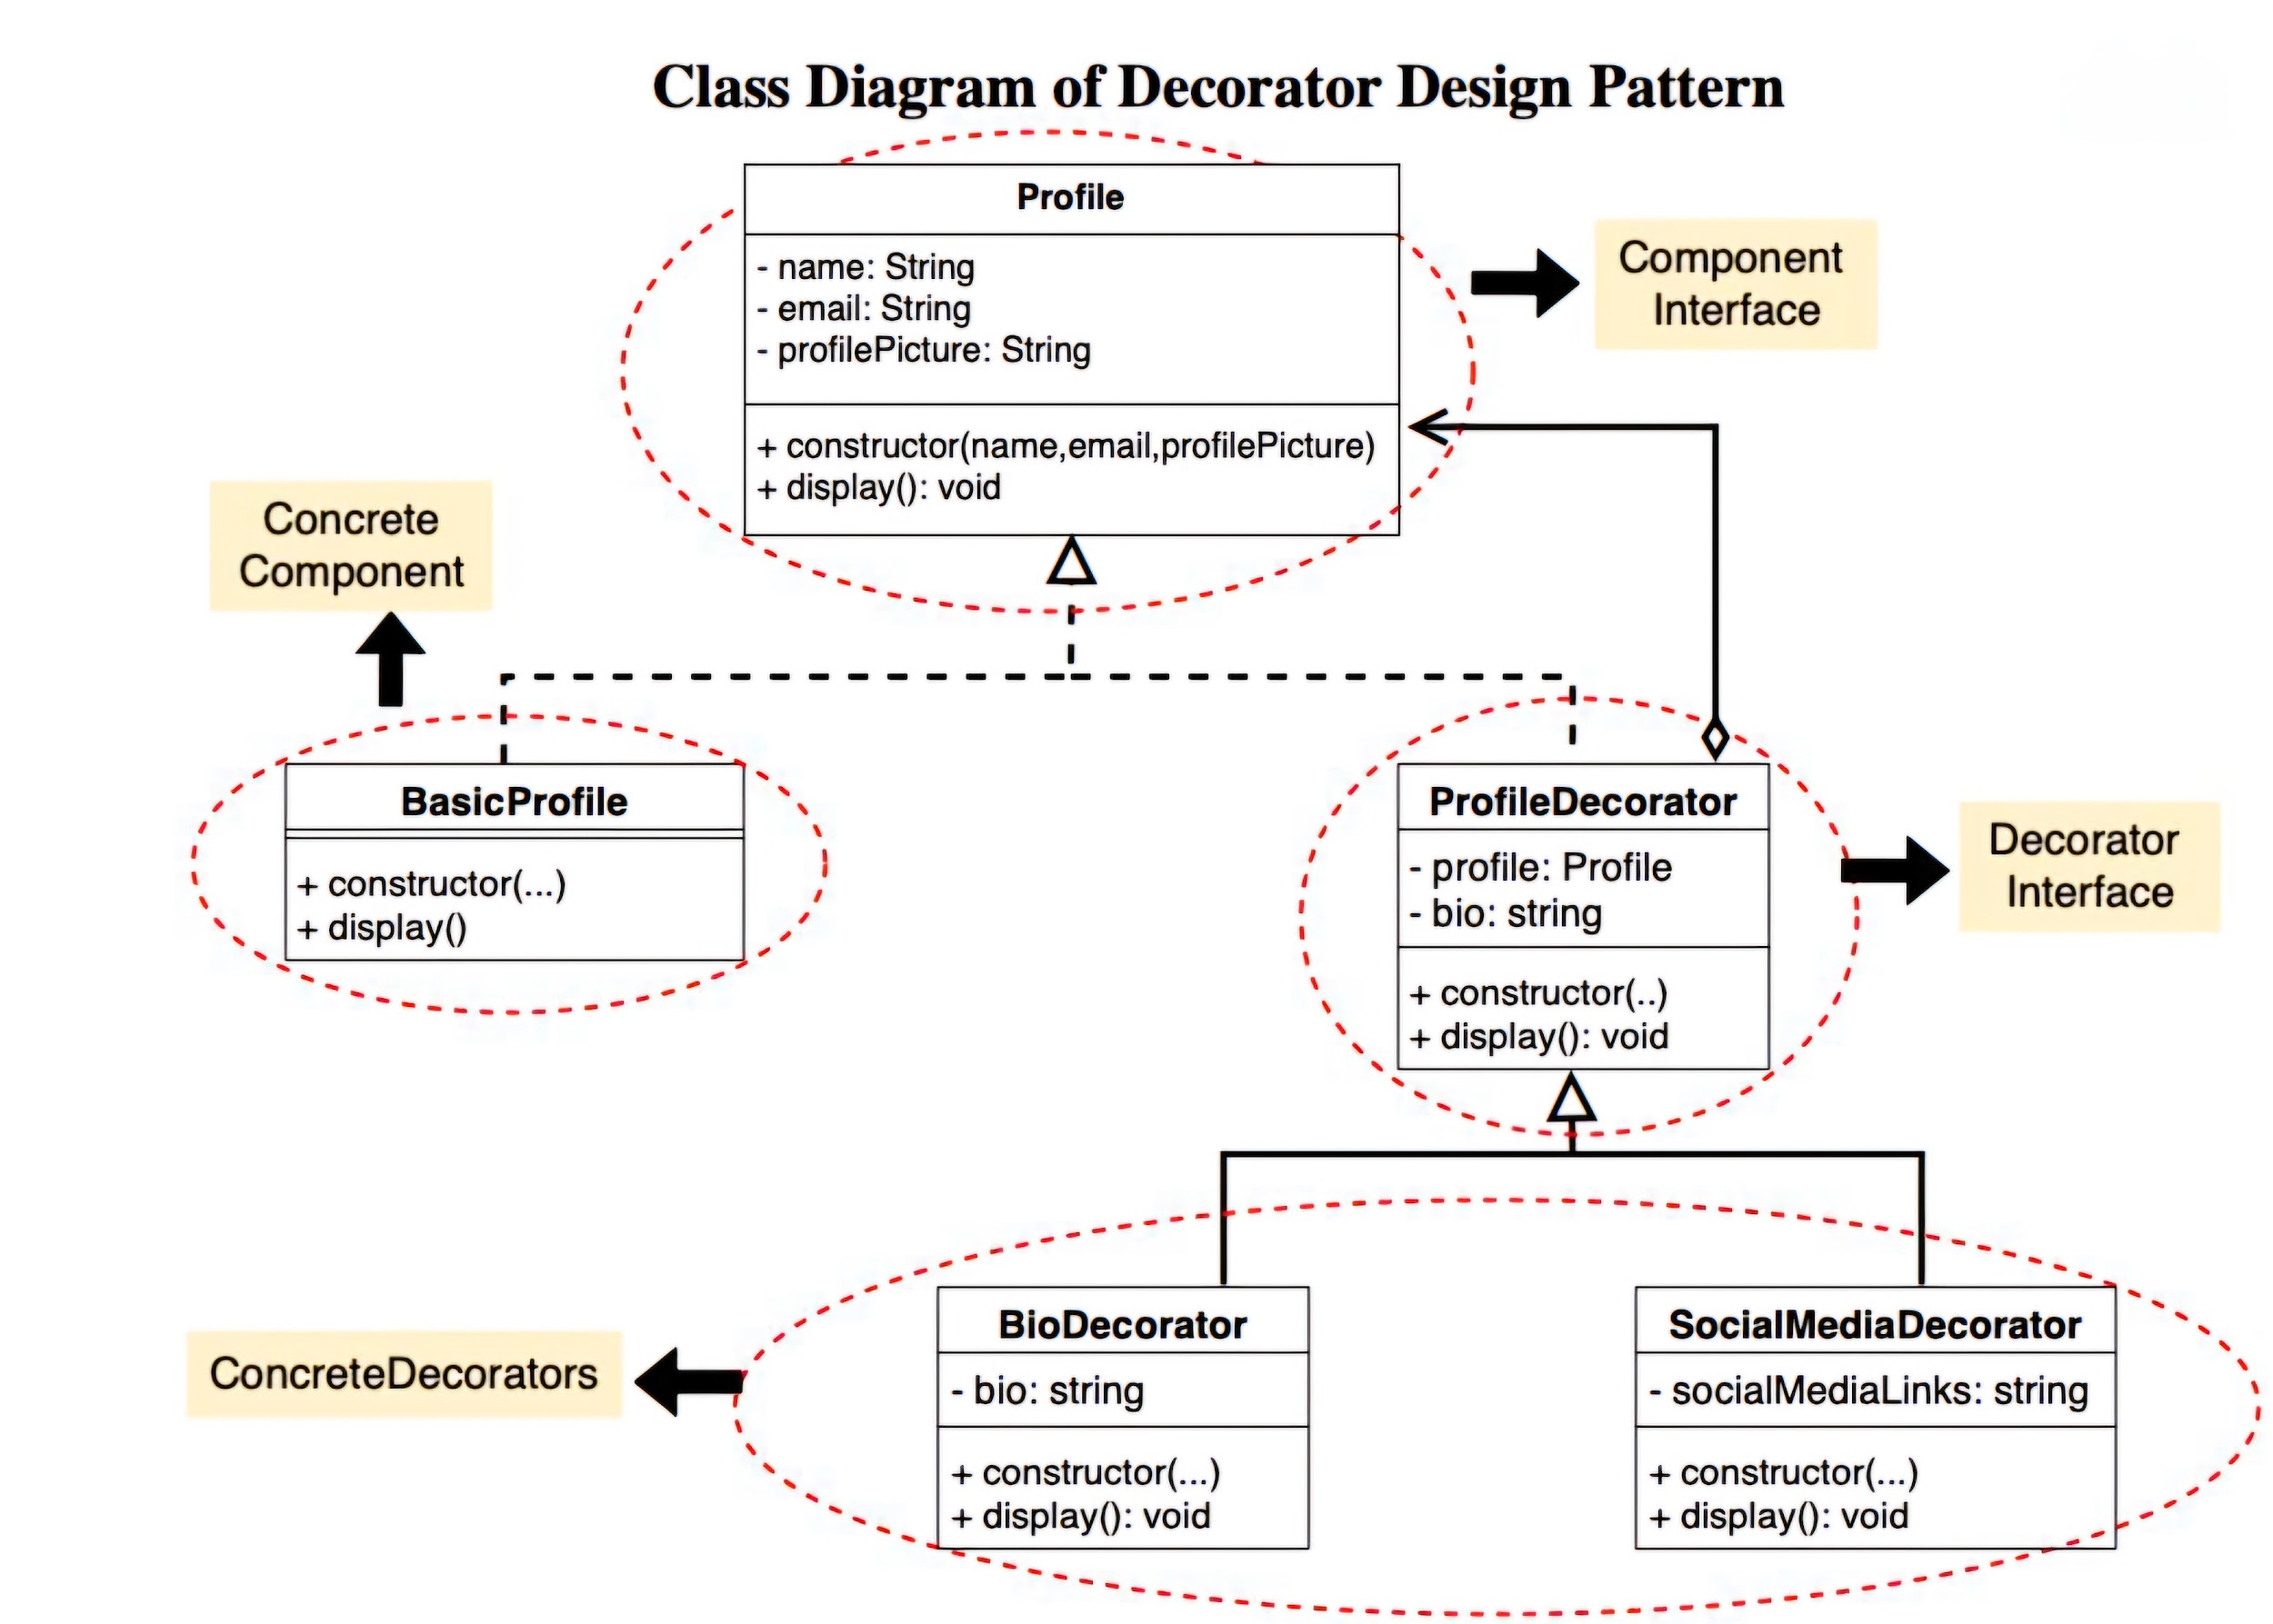

Slide 43
Use Cases:
GUIs: Add features like borders or tooltips dynamically.
Logging: Add logging functionality without modifying core logic.
Dynamic Behavior: Add logic like discounts or pricing.
Library Extension: Extend third-party libraries with custom features.
Feature Toggle: Enable/disable features based on conditions.

Slide 44
2.5 Facade Method Design Pattern:
It simplifies interaction with a complex subsystem by providing a unified, high-level interface, hiding internal complexities.
Features:
Simplifies Interactions: Hides complexities of subsystems.
Reduces Coupling: Minimizes dependencies between client and subsystem.
Improves Maintainability: Centralizes access for easier updates.

Slide 45
Components:
Facade: Central interface coordinating subsystem classes and delegating client requests.
Subsystem Classes: Implement actual functionality, unaware of the facade.
Client: The client is the external entity that interacts with the system via the facade.

Slide 46
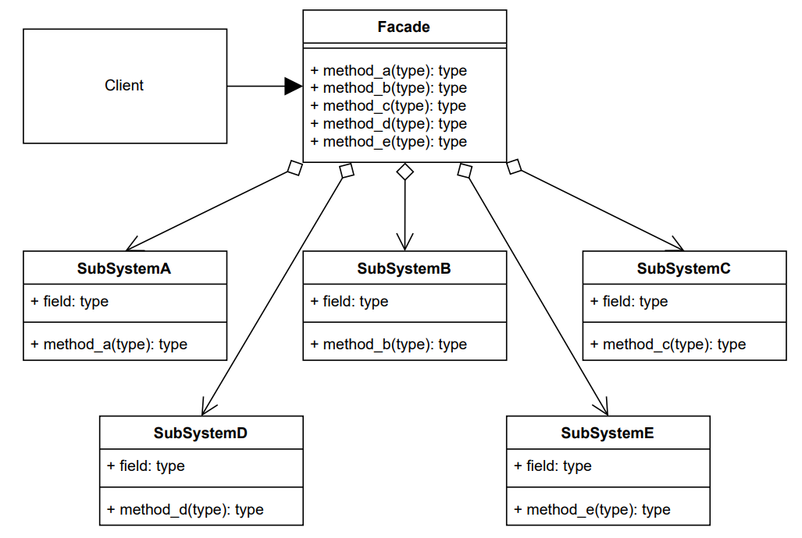

Slide 47
Use Cases:
Simplify Complex Systems: Unified interface for managing multiple subsystems.
Promote Loose Coupling: Reduces client dependency on subsystems.

Slide 48
2.6 Proxy Method Design Pattern:
It provides an object that acts as a placeholder to control access to another object, handling tasks like security, caching, or lazy initialization.
Features:
Expensive Object Creation: Delays object instantiation to optimize resource usage.
Uncontrolled Access: Adds a layer to enforce security or permission checks.
Redundant Computations: Reduces repetitive tasks by caching results.

Slide 49
Components:
RealSubject: Implements business logic and actual resource.
Proxy: Controls access to the RealSubject, adding extra functionality like lazy loading or security.
Client: The entity that interacts with the Proxy or RealSubject.

Slide 50
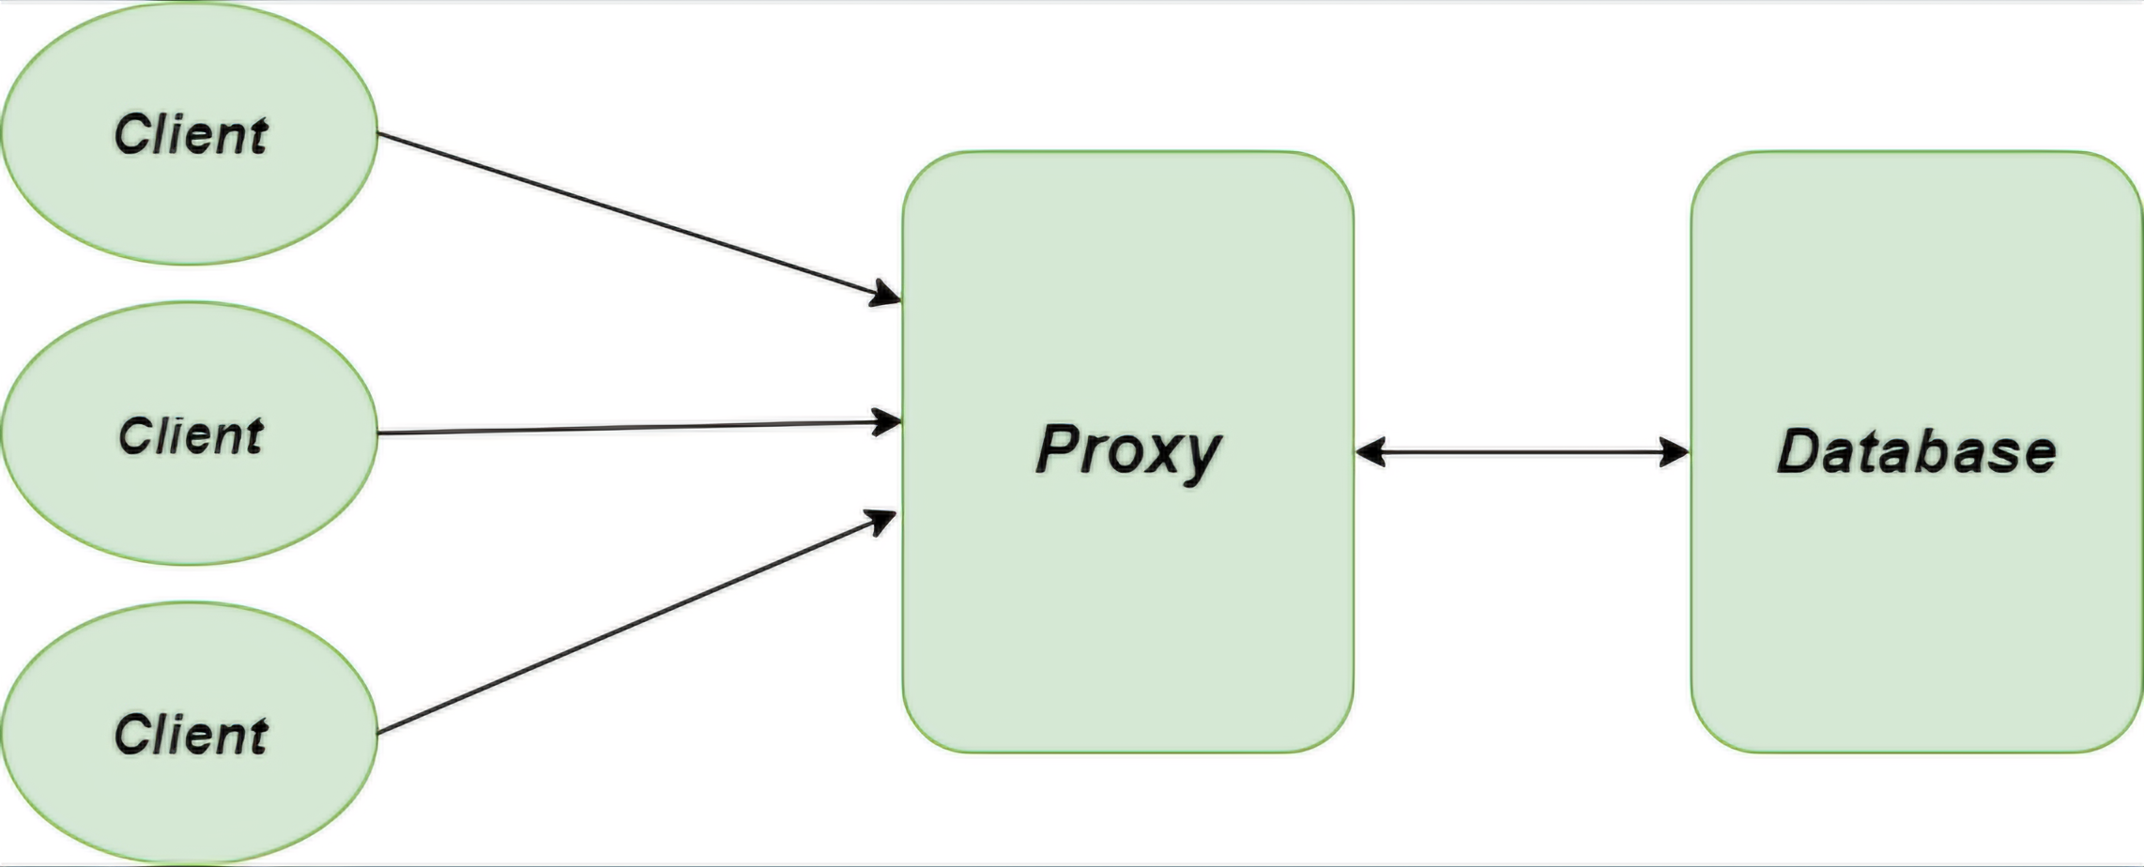

Slide 51
Use Cases:
Lazy Loading: Delays object creation to improve performance.
Access Control: Enforces security and permission checks.
Caching: Stores results to optimize performance.
Distributed Systems: Simplifies remote communication between clients and objects.

Slide 52
2.7 Flyweight Method Design Pattern:
It reduces memory usage by sharing common data across objects, reusing them instead of creating duplicates.
Features:
Optimized Memory & Performance: Reduces memory use and boosts performance by sharing common data.
Efficient Object Handling: Reuses objects in large systems.

Slide 53
Components:
Flyweight Interface/Class: Defines shared behavior for flyweight objects.
Concrete Flyweight: Implements the interface, stores and manipulates intrinsic state.
Flyweight Factory: Manages the pool of shared objects and ensures reusability.
Client: Uses flyweight objects and provides extrinsic state as needed.

Slide 54
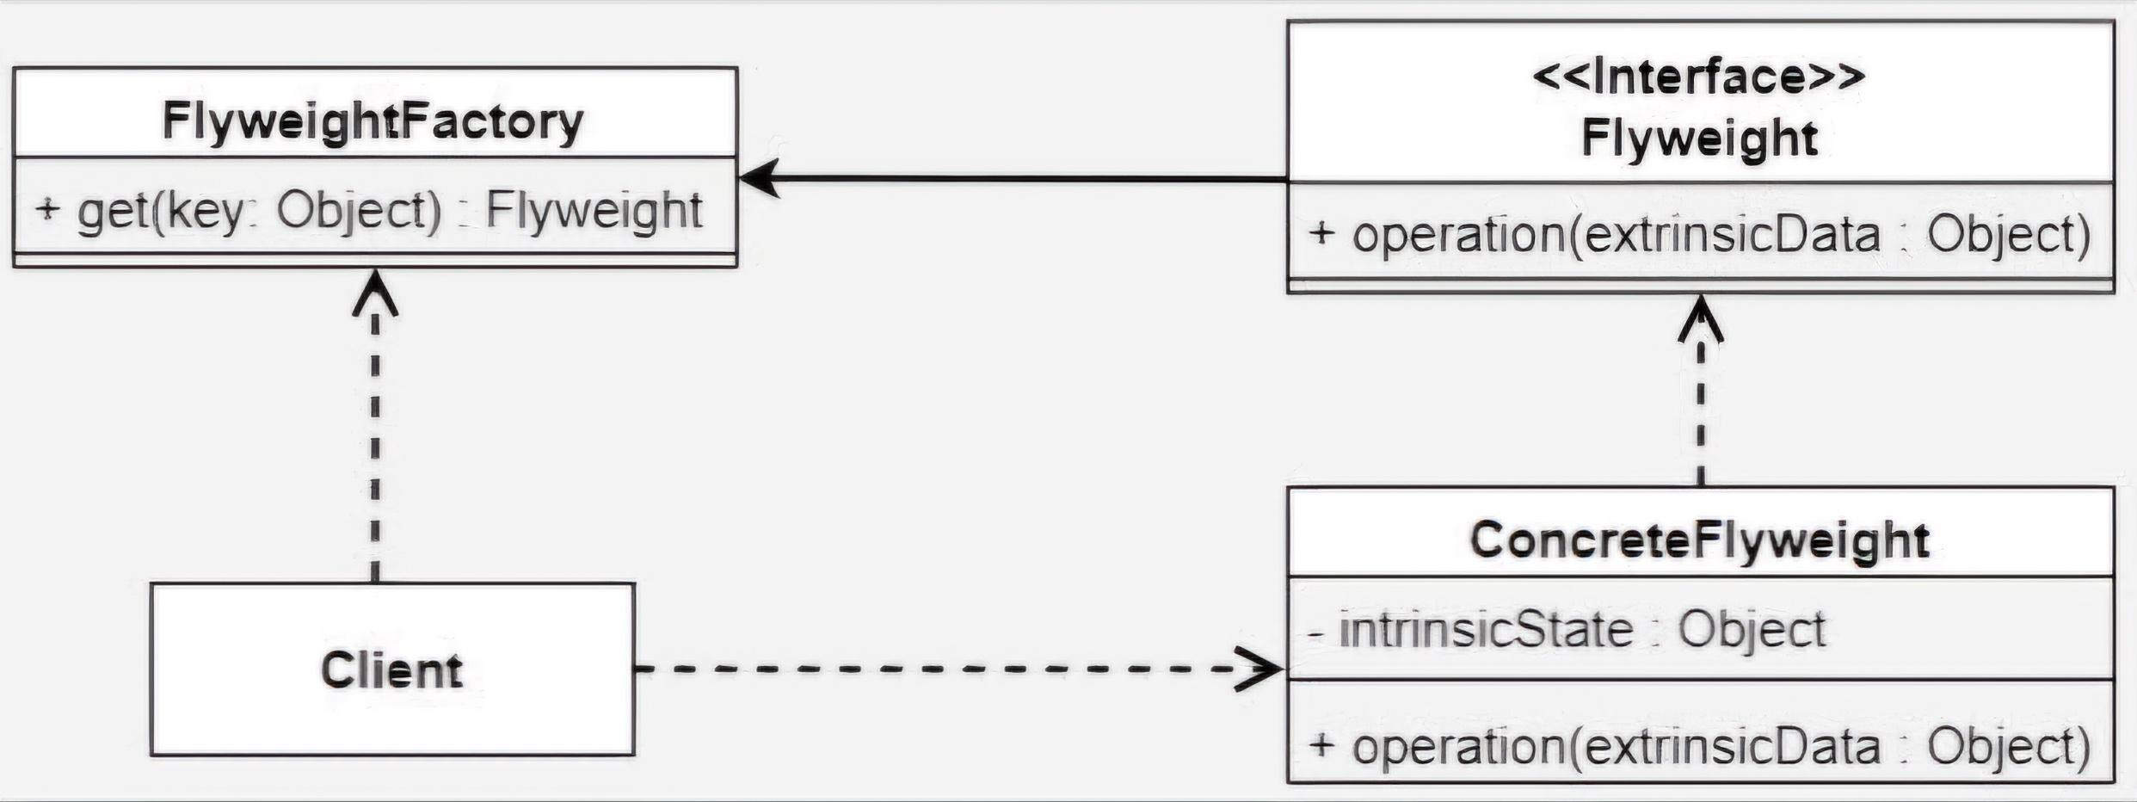

Slide 55
Use Cases:
Numerous Similar Objects: For objects with shared attributes (e.g., UI elements).
Memory Optimization: Reduces RAM usage by sharing common data.
Improved Performance: Minimizes object creation overhead.
Cost Reduction: Saves space and reduces project costs.

Slide 56
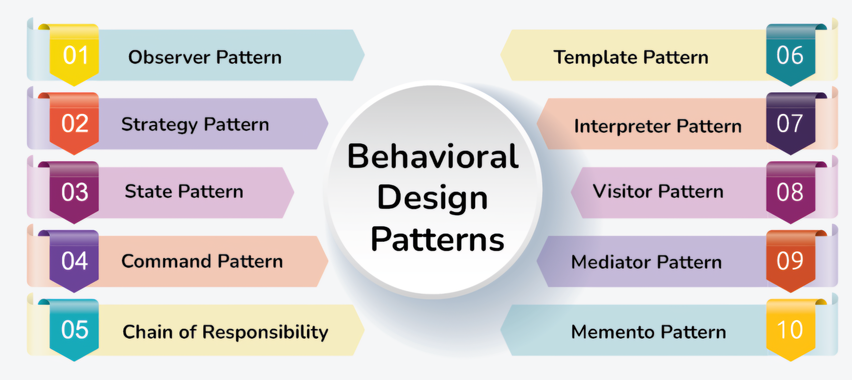
3. Behavioral Design Patterns:
It focus on object communication and interactions, defining how objects collaborate and share responsibilities, simplifying complex control flow in a system.
Types:

Slide 57
3.1 Observer Method Design Pattern:
It notifies dependent objects (observers) of state changes in a subject, either automatically or manually.
Features:
Real-time Updates: Observers get updates immediately when the subject's state changes.
Loose Coupling: Subjects and observers are loosely coupled, allowing independent changes.
One-to-Many Dependency: One subject can have multiple observers.

Slide 58
Components:
Subject: Maintains state and notifies observers of changes.
ConcreteSubject: The actual implementation of the subject that holds state and sends notifications.
Observer: Defines the update interface for receiving notifications.
ConcreteObserver: Implements the update method to respond to notifications from the subject.

Slide 59
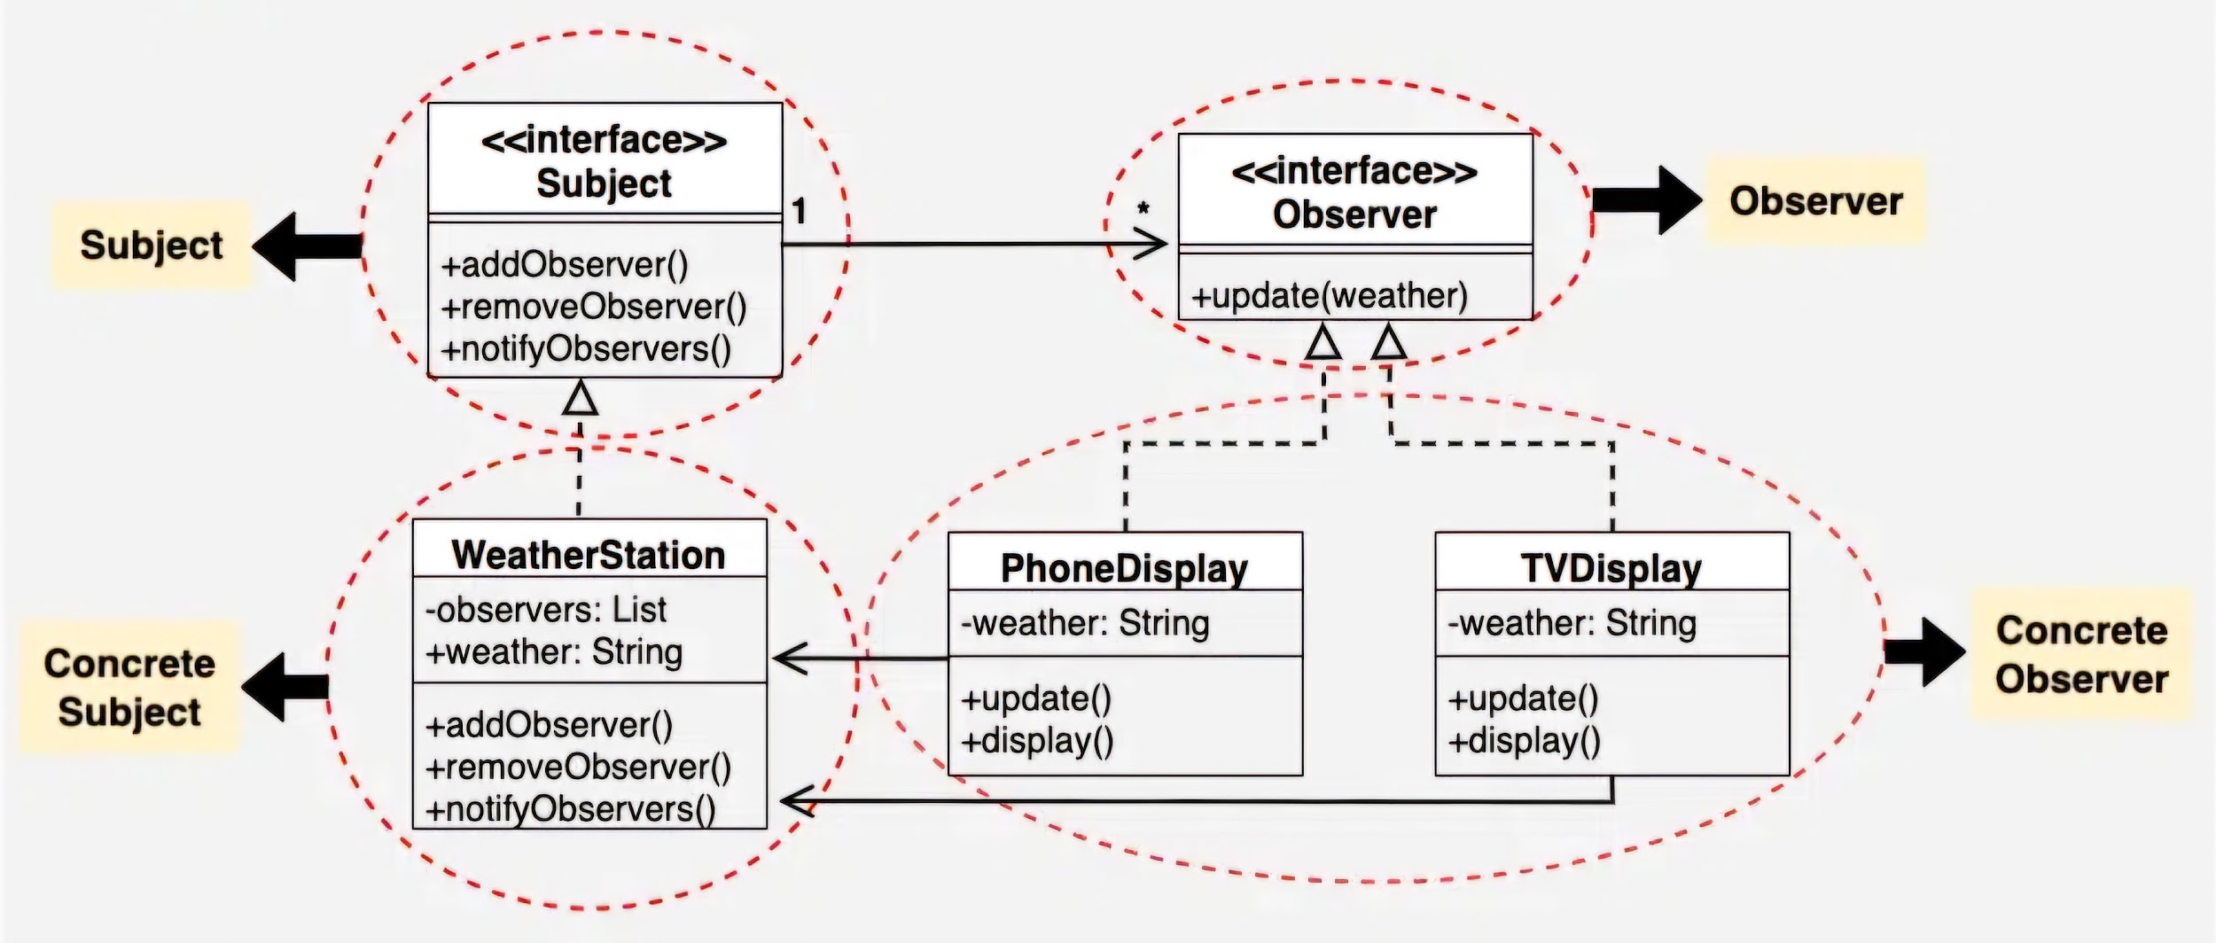

Slide 60
Use Cases:
Real-Time Data: Applications like stock markets or weather stations.
Notification Systems: Email or messaging platforms notifying users.

Slide 61
3.2 Strategy Method Design Pattern:
It allows selecting an algorithm or behavior at runtime, making it interchangeable without changing the client code.
Features:
Runtime Flexibility: Allows dynamic switching of algorithms at runtime.
Decoupling: Separates behavior (action) from the context, allowing independent modification.
Interchangeability: Strategies can be easily swapped without changing the client code.

Slide 62
Components:
Context: It manages the strategy and represent the system itself.
Strategy Interface: Defines a common method all strategies must follow.
Concrete Strategies: Actual implementations of the strategy interface.
Client: Chooses and sets the strategy for the context.

Slide 63
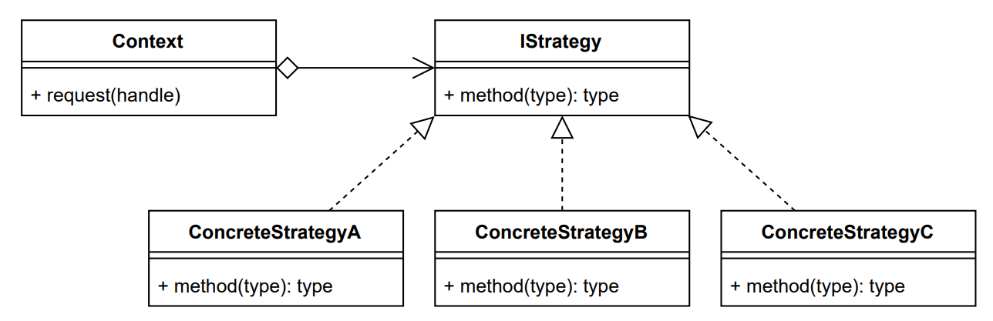

Slide 64
Use Cases:
Payment Systems: Dynamically switch between payment methods (e.g., Credit Card, PayPal).
Sorting Algorithms: Choose sorting methods (e.g., Quick Sort, Merge Sort) at runtime.
Routing Algorithms: Select different navigation strategies (e.g., fastest, shortest path).

Slide 65
3.3 State Method Design Pattern:
It lets an object change its behavior (action) based on its current state by using different classes for each state.
Features:
State-specific behavior: Behavior changes based on the object's state.
Encapsulation: States are managed by separate classes, making code easier to manage.
Flexible and scalable: New states can be added without modifying existing code.

Slide 66
Components:
State Interface: Defines a method to change the state.
Concrete States: Implement state-specific behaviors (Green, Yellow, Red).
Context: It manages the states and represent the system itself.

Slide 68
Use Cases:
Dynamic behavior change: Systems where an object's behavior changes based on its internal state.
Simplified state management: When an object can be in multiple states, and each state requires specific behavior.
Scalable state transitions: Systems that need to add more states or transitions without altering the existing codebase.

Slide 69
3.4 Command Method Design Pattern:
It encapsulates requests as objects to support queuing, logging, undo, and decoupling the sender from the receiver.
Features:
Encapsulation: Encapsulates a request as an object.
Decoupling: Decouples sender (Invoker) from receiver (Executor).
Flexibility: Allows dynamic changes to requests at runtime.

Slide 70
Components:
Command: A blueprint defining the action to be performed and a way to undo it.
Concrete Command: Specific implementation of an action, often linked to the object performing it.
Receiver: The entity that carries out the actual work or task when a command is executed.
Invoker: The handler or manager that triggers the execution of commands and may store them for future use (e.g., undo/redo).
Client: The originator that decides the actions, creates the commands, and connects them to the invoker.

Slide 71
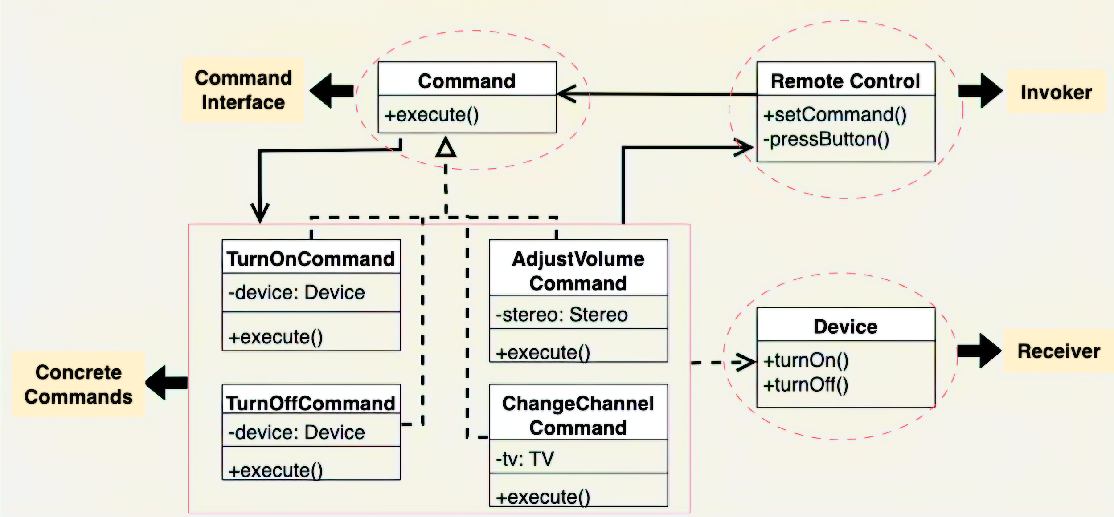

Slide 72
Use Cases:
Decoupling Invoker and Receiver: Reduces dependency between the requestor and the executor of actions.
Undo/Redo Functionality: Simplifies the management of undo/redo actions.
Command Queuing: Supports queuing commands for deferred execution or scheduling.

Slide 73
3.5 Chain of Responsibility Design Pattern:
It is a behavioral pattern where multiple handlers process a request, passing it along the chain until one handles it.
Features:
Chain of Handlers: Requests pass through a chain of handlers for processing.
Flexible Processing: Handlers can be added or removed dynamically.

Slide 74
Components:
Handler: Defines the request handling interface.
ConcreteHandler: Implements specific request handling.
Client: Initiates the request and starts the chain.

Slide 75
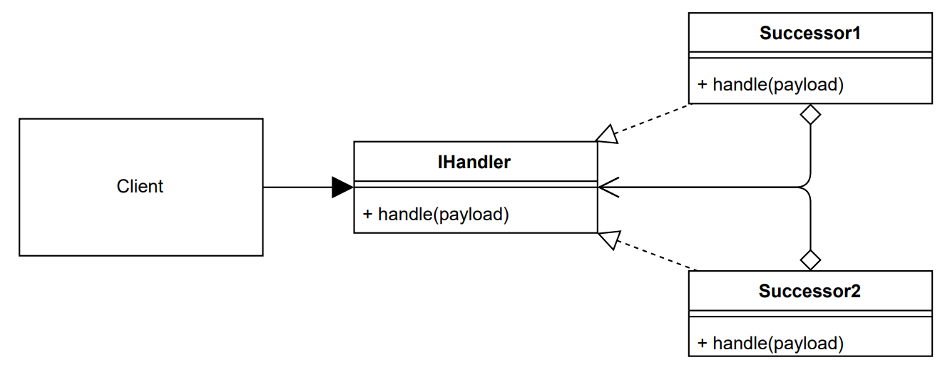

Slide 76
Use Cases:
Logging Systems: Efficiently handling different log levels.
Event Handling: Managing user inputs or system events.
Middleware in Web Servers: Processing HTTP requests through filters.
Workflow Management: Passing tasks through multiple stages.

Slide 77
3.6 Template Method Design Pattern:
It defines the structure of an algorithm in a base class, letting subclasses override specific steps without changing the overall structure.
Features:
Algorithm Skeleton: Defines the overall structure of the algorithm, with certain steps left to subclasses.
Extensibility: Subclasses can override specific steps without modifying the whole algorithm.
Code Reusability: Common steps are implemented in the base class, promoting reuse.

Slide 78
Components:
Abstract Class: Defines the skeleton of the algorithm (steps for data processing).
Concrete Class: Implements the specific details of the steps (e.g., reading, transforming, and saving data).
Template Method: The high-level method in the abstract class that calls the concrete methods in a predefined order.

Slide 79
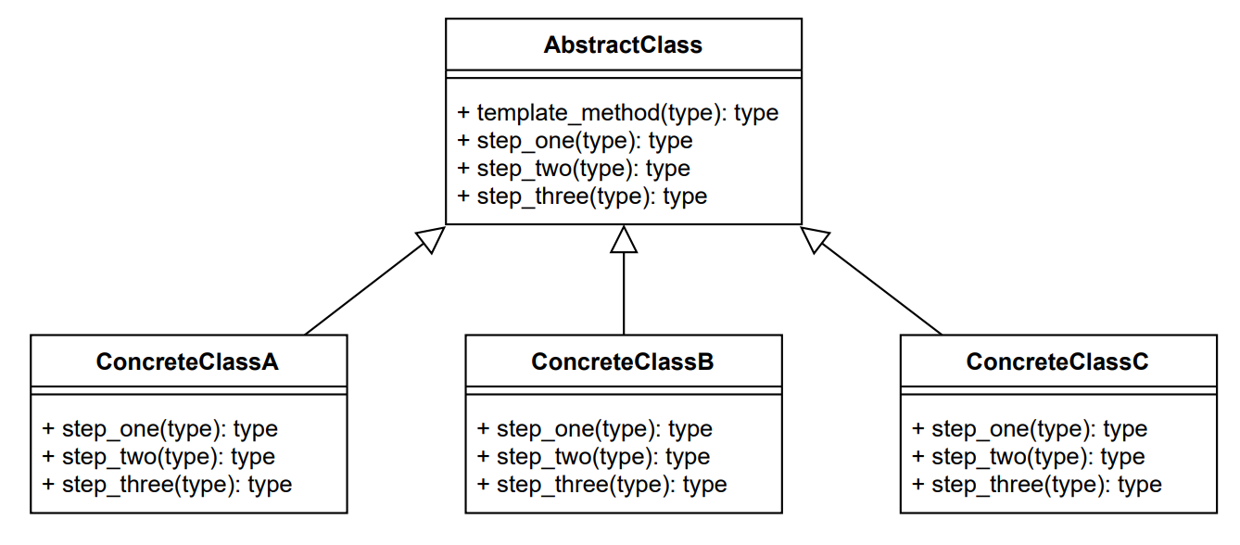

Slide 80
Use Cases:
Workflow Systems: In systems with predefined workflows (e.g., order processing), where certain steps are common, but others may vary.
Document Generation: In generating reports or documents with similar structure but customizable content (e.g., invoices, contracts).
Data Processing Pipelines (ETL): Common structure for validation, transformation, and loading; different logic for each data type.

Slide 81
3.7 Interpreter Method Design Pattern:
It defines a language's grammar and interprets sentences, enabling flexible evaluation and modification of expressions.
Features:
Recursive Evaluation: Evaluates complex expressions recursively based on grammar rules.
Extensibility: Easily extendable by adding new expression classes or rules.
Structured Representation: Organizes expressions into a clear and structured format (e.g., Abstract Syntax Tree).

Slide 82
Components:
Abstract Expression: Defines an interface for interpreting an expression.
Terminal Expressions: Represents values (like numbers in an expression).
Non-Terminal Expressions: Represents operators (like addition, multiplication, etc.).
Context: Holds any additional information needed for interpretation.

Slide 83
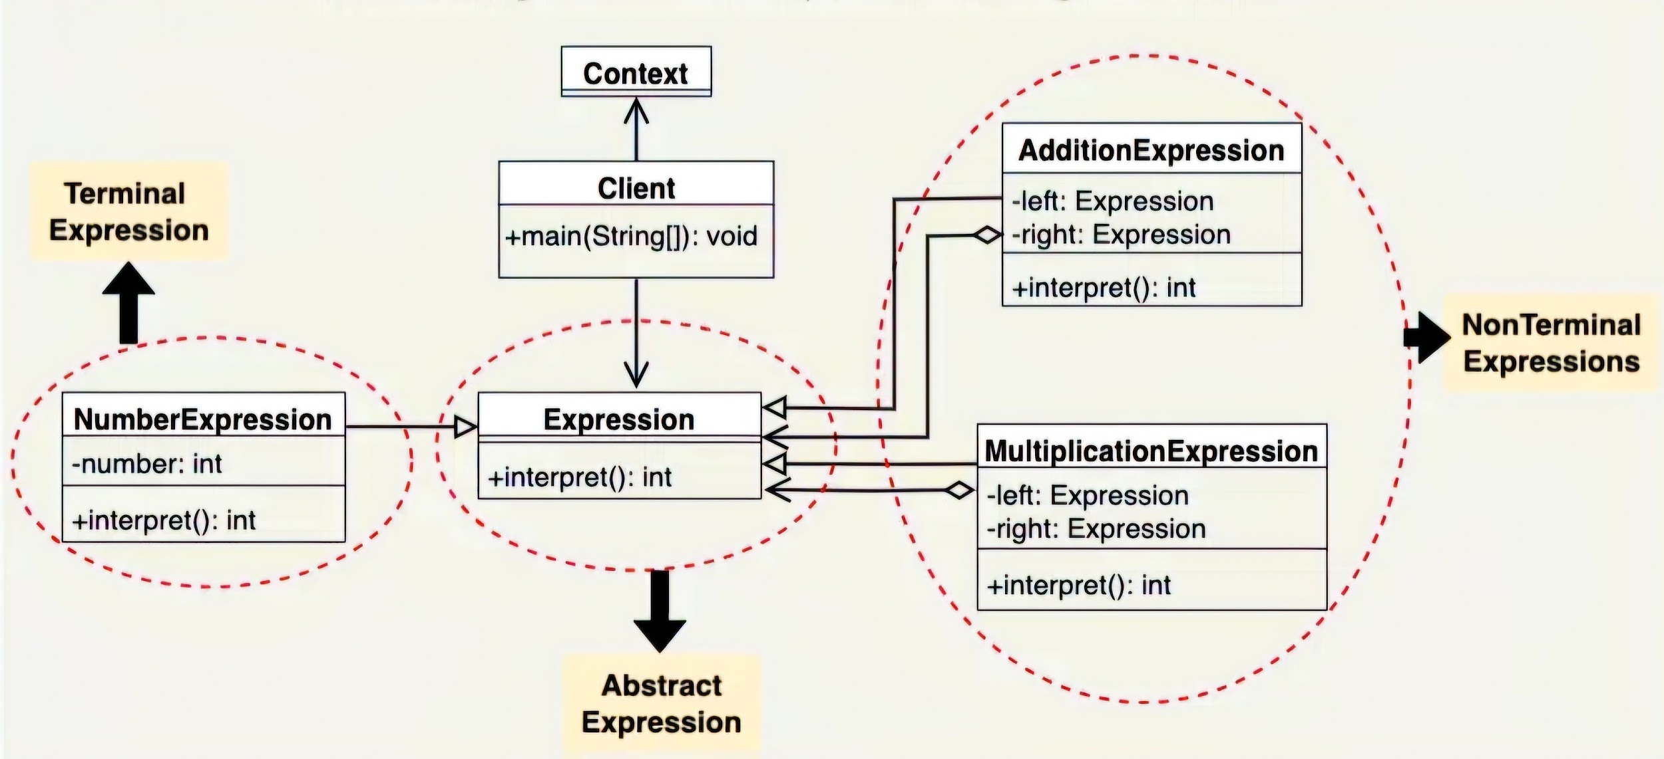

Slide 84
Use Cases:
Mathematical Expression Evaluator: Evaluating expressions like "3 + 5 * (2 - 8)".
SQL Query Processor: Parsing and executing SQL queries.
Pattern Matching: Matching complex patterns in text (e.g., regular expressions).

Slide 85
3.8 Visitor Method Design Pattern:
It allows adding new operations to existing object structures without modifying their classes, by using a separate visitor class.
Features:
Separation of Concerns: Adds operations without changing object structures.
Extensibility: Easily add new operations by creating new visitors.
Centralized Operations: Keeps all operations in one place (visitor) for easier management.

Slide 86
Components:
Visitor Interface: Declares operations for all item types.
Concrete Visitors: Implements specific operations like calculating totals or applying discounts.
Element Interface: Declares the accept method to allow visitors to operate on items.
Concrete Elements: Represents different item types (e.g., books, electronics).

Slide 87
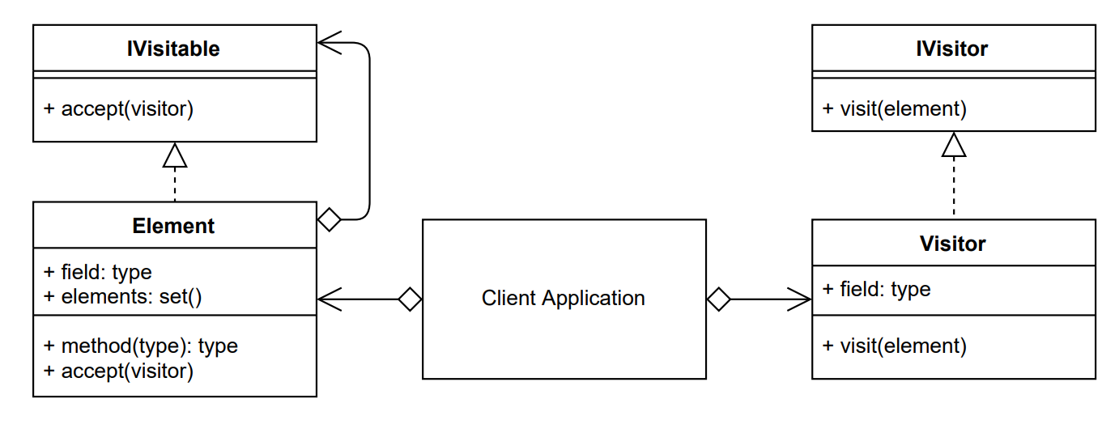

Slide 88
Use Cases:
Applying Operations Without Modifying Classes: Allows adding new behaviors to existing objects without changing their implementation.
Processing Complex Data Structures: Facilitates operations on hierarchical or complex data structures (trees, graphs) without modifying the underlying structures.

Slide 89
3.9 Mediator Method Design Pattern:
It centralizes communication between objects, reducing direct dependencies and promoting loose coupling.
Features:
Centralized Communication: Simplifies interactions and reduces dependencies between objects.
Scalability: Enables easy addition or modification of components without impacting others.
Improved Maintenance: Centralized logic enhances readability and maintainability.

Slide 90
Components:
Mediator Interface: Defines the contract for communication between objects.
Concrete Mediator: Implements the communication logic, coordinating interactions.
Colleagues: Abstract base class for objects that interact through the mediator.
Concrete Colleagues: Specific implementations of Colleagues that communicate via the mediator

Slide 91
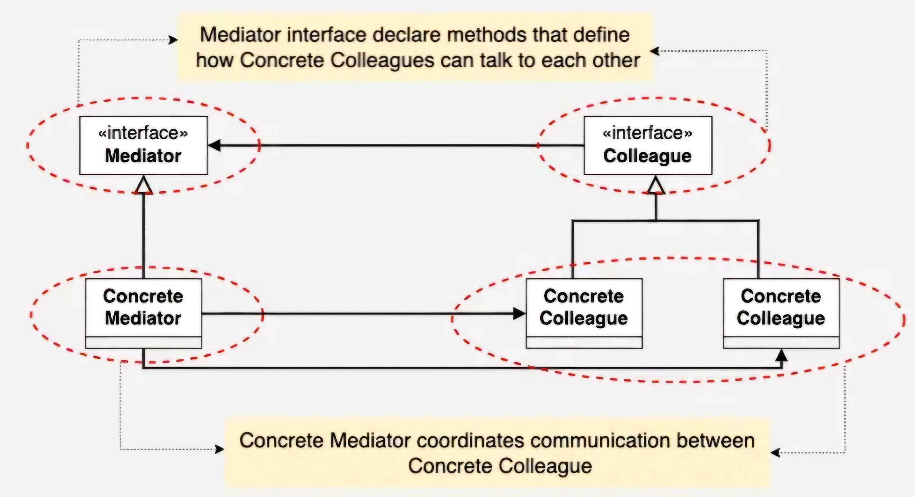

Slide 92
Use Cases:
Managing User Interface Components: Coordinates interactions between UI elements like forms, buttons, or dialog boxes to reduce dependencies.
Centralized Coordination in Distributed Systems: Manages inter-service communication and state in distributed architectures (e.g., microservices or message brokers).

Slide 93
3.10 Momento Method Design Pattern:
It lets an object store its state without exposing its structure, allowing it to be restored later.
Features:
Undo Functionality: Supports the ability to undo changes in an object.
Encapsulation: Preserves the internal state of an object without exposing it.
Separation of Concerns: Keeps state management separate from the object’s behavior.

Slide 94
Components:
Memento: Stores the object's state.
Originator: The object whose state is to be saved or restored.
Caretaker: Manages and keeps track of the mementos, but doesn't alter them.

Slide 95
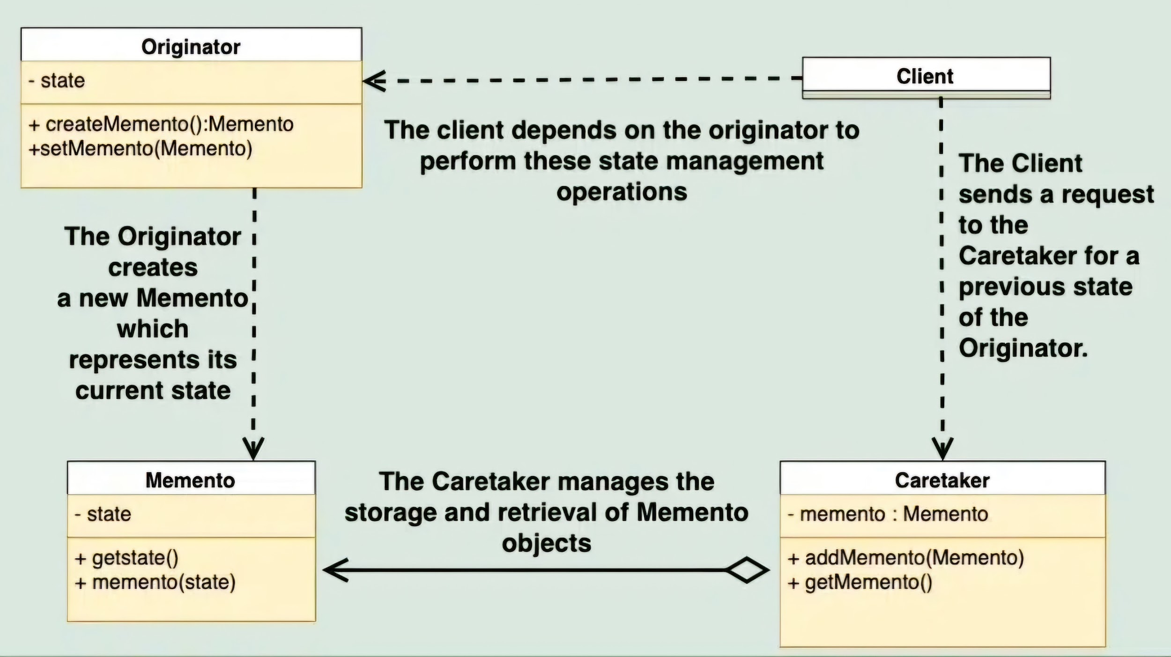

Slide 96
Use Cases:
Undo/Redo functionality: Storing states to allow reverting back to previous states in applications like text editors.
Checkpointing: Saving an object's state at certain intervals, allowing rollback to earlier states in case of failure.
State preservation: Maintaining the state of an object when the object undergoes changes or is passed around in a system.

Slide 97
III. References:
Website- geeksforgeeks.org/software-design-patterns
Book- Gang of Four- Software Design Pattern/ Python
Book- Gang of Four- Software Design Pattern
Book- Head First Design Pattern
Youtube- Christopher Okhravi
Youtube- Geekific

Slide 98
Thank You

